Slide 1

NORTHWIND
DATA ANALYSIS

Slide 2
DATASET OVERVIEW
Northwind is a fictional business specializing in a variety of products,including beverage,condiments,confections,dairy products,cereals,meat,produce,and seafood.The dataset includes files such as categories,customer details,employee details,order details,orders and products questions were provided to query the dataset

Slide 3
        WHAT IS DATA ANALYSIS
        Data analytics is the process of examining data sets to uncover hidden patterns, trends, and insights, ultimately Leading to better decision-making.

Slide 4
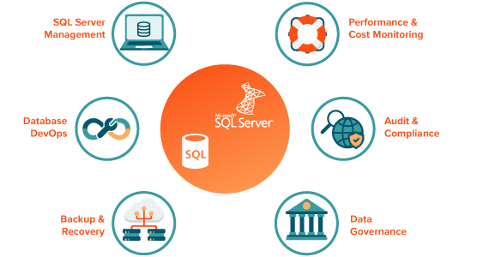
Tools used
1.SQL management server

Slide 5
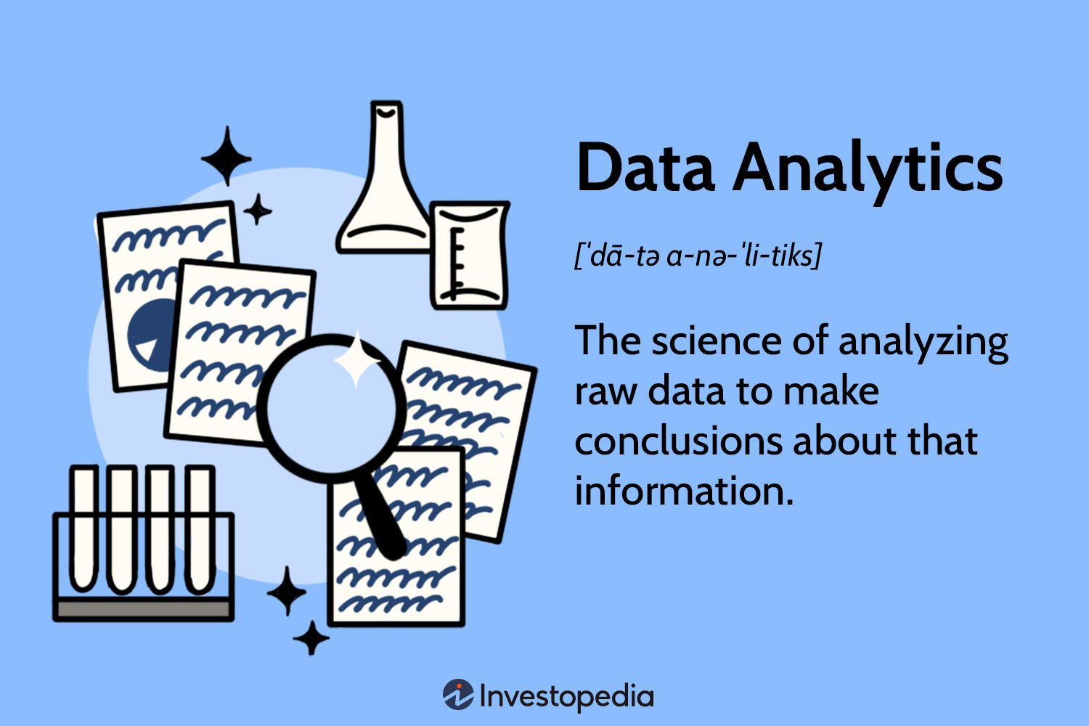
Steps followed
Imported Northwind dataset into SQL Server
Used SQL functions to query dataset and answer the questions
Copied the output

Slide 6
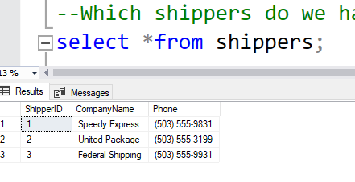
1.Which shippers do we have

Slide 7
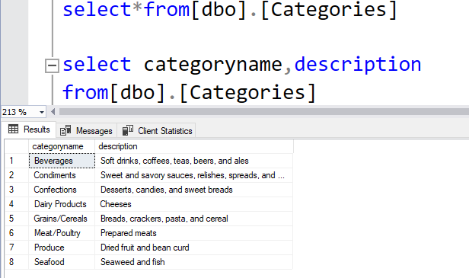
2.Certain fields from categories

Slide 8
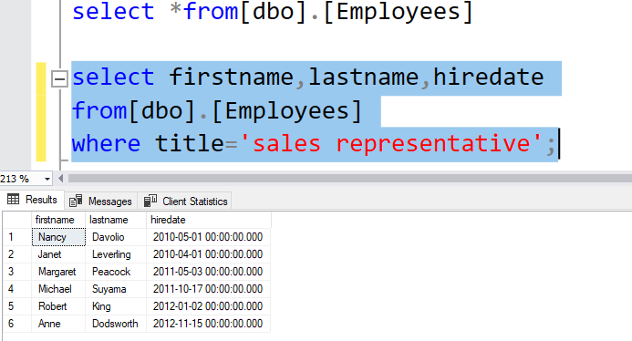
3.Sales representatives

Slide 9
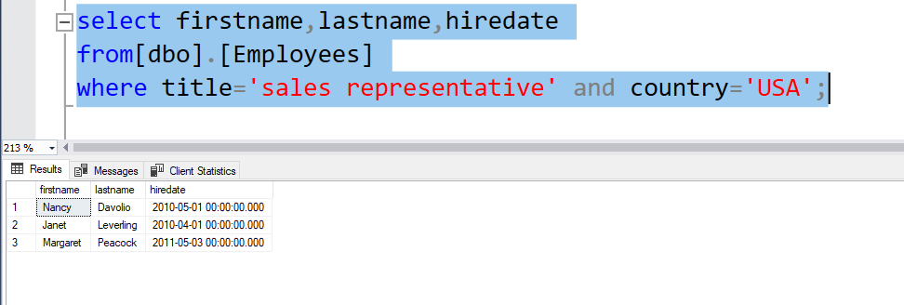
4.Sales representative in the united states

Slide 10
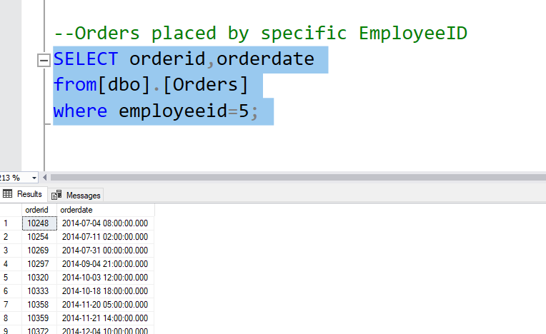
5.Order placed by specific EmployeeId

Slide 11
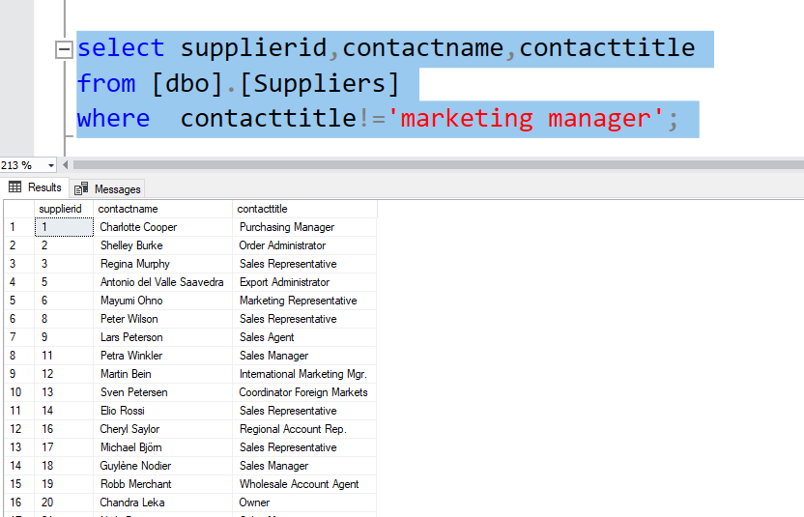
6.Suppliers and contact titles

Slide 12
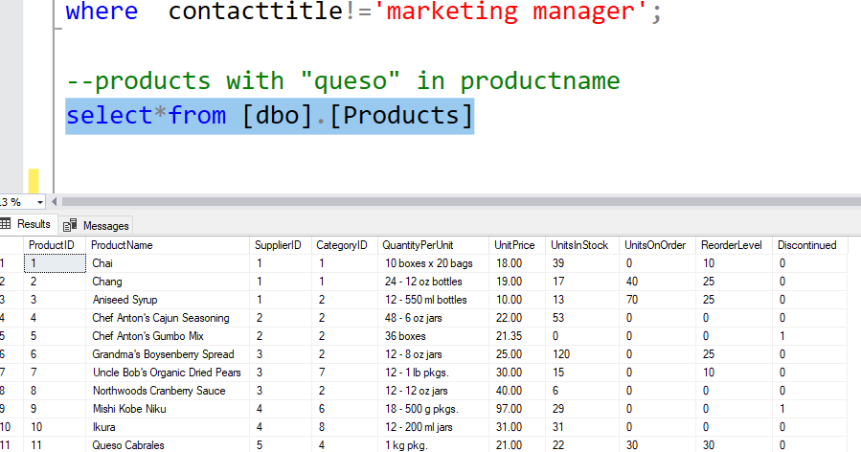
7.products with "queso" in productname

Slide 13
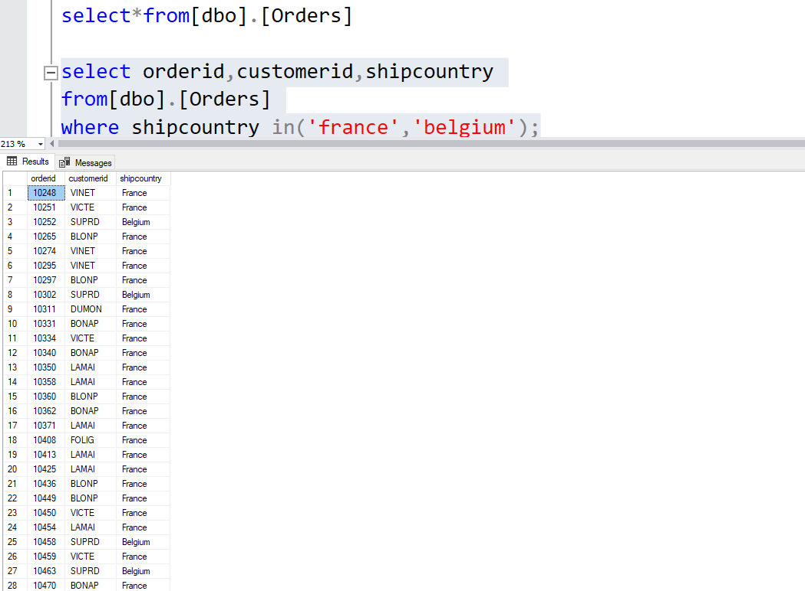
8.orders shipping in france or belgium

Slide 14
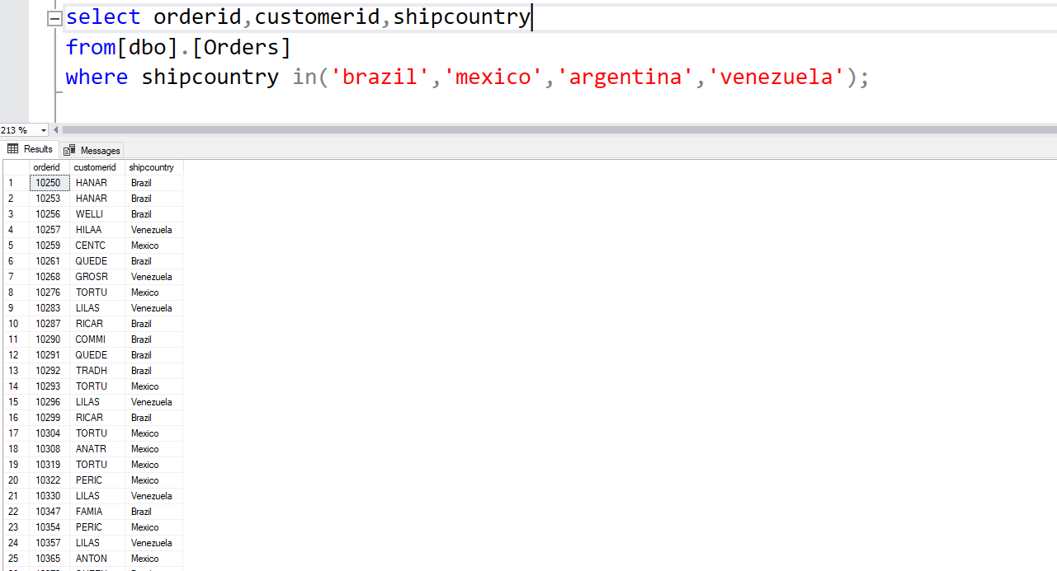
9.orders shipping to any country in latin america

Slide 15
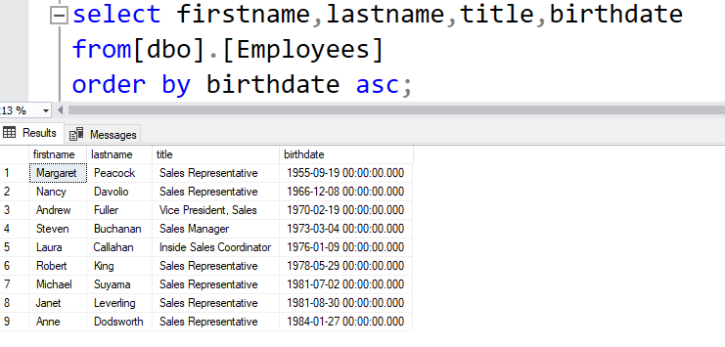
10.Employees in order of age

Slide 16
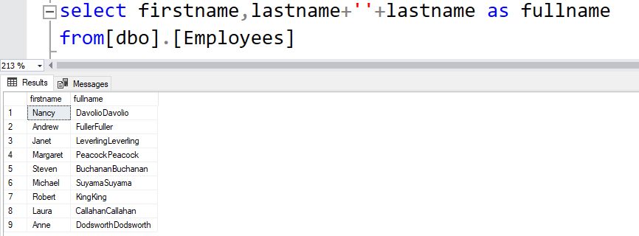
11.employees full name

Slide 17
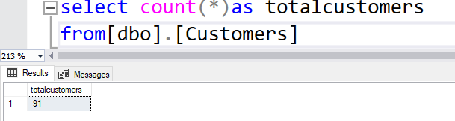
12.How many customers?

Slide 18
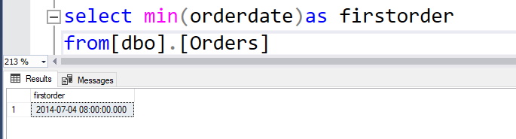
13.When was the first order

Slide 19
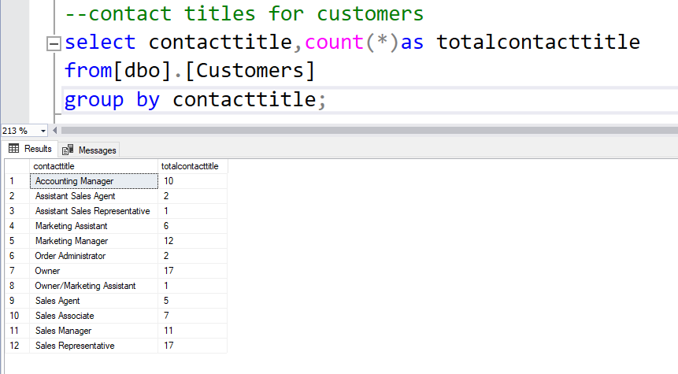
14.contact titles for customers

Slide 20
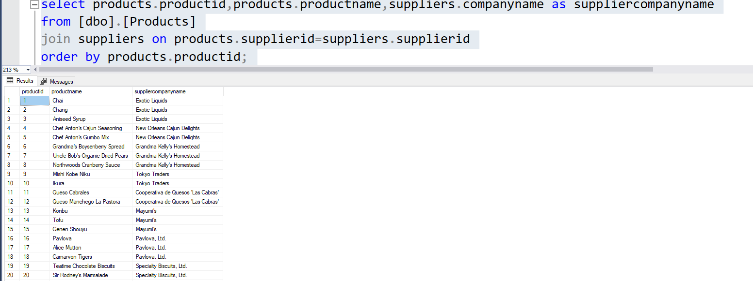
15.Products with associated supplier name

Slide 21
THANKYOU
CREATED BY :
SNEHA.S

